Slide 1
Parameters of Cache memory
Cache Hit
A referenced item is found in the cache by the processor
Cache Miss
A referenced item is not present in the cache
Hit ratio
Ratio of number of hits to total number of references => number of hits/(number of hits + number of Miss)
Miss penalty
Additional cycles required to serve the miss

Slide 2
Parameters of Cache Memory
Time required for the cache miss depends on both the latency and bandwidth
Latency – time to retrieve the first word of the block
Bandwidth – time to retrieve the rest of this block

Slide 3
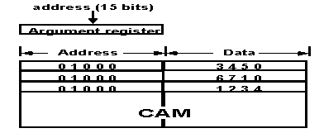
Associative Mapping
Fastest, most flexible but very expensive
Any block location in cache can store any block in memory
Stores both the address and the content of the memory word
CPU address of 15 bits is placed in the argument register and the associative memory is searched for a matching address
If found data is read and sent to the CPU else main memory is accessed.
CAM – content addressable memory

Slide 4
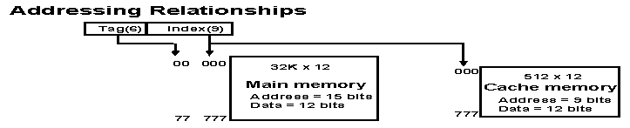
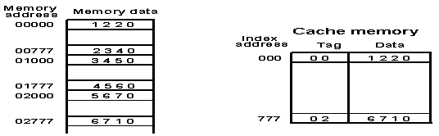
Direct Mapping
N-bit CPU memory address – k bits index field and (n-k) bits tag field
Index bits are used to access the cache
Each word in cache consists of data word and its associated tag
On memory request, index field is used to access the cache. Tag field of CPU address is compared with the tag in the word read in the cache

Slide 5
If match then there is hit
Else miss – word is read from the memory
It is then stored in the cache together with the new tag replacing the previous value
Disadvantage: hit ratio drops if 2 or more words with same index but different tags are accessed repeatedly.
When memory is divided into blocks of words, index field – block field and word field
Ex: 512 words cache – 64 blocks of 8words each – block field (6bits) and words field (3bits)

Slide 6
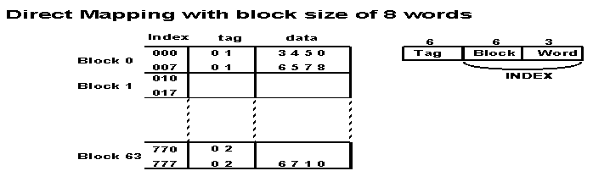
Tags within the block are same.
When a miss occurs, entire block is transferred from main memory to cache.
It is time consuming but improves hit ratio because of the sequential nature of programs.

Slide 7
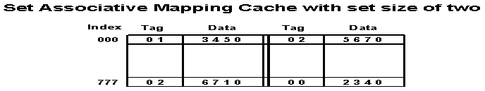
Set-Associative Mapping
Each word of cache can store 2 or more words of memory under the same index address
The comparison logic is done by an associative search of the tags in the set similar to an associative memory search, thus the name “Set-Associative”

Slide 8
Hit ratio increases as the set size increases but more complex comparison logic is required when number of bits in words of cache increases
When a miss occurs and set is full, one of tag-data items are replaced using block replacement policy

Slide 9
Problems
A set associative cache consists of 64 lines or slots, divided into four line sets. Main memory consists 4k blocks of 128 words each. Show the format of main memory addresses.

Slide 10
Problem 2
A two-way set associative cache has lines of 16 bytes and a total size of 8k bytes. The 64-Mbyte main memory is byte addressable. Show the format of main memory addresses.

Slide 11
Block Replacement
Least Recently Used: (LRU)
Replace that block in the set that has been in the cache longest with no reference to it.
First Come First Out: (FIFO)
Replace that block in the set that has been in the cache longest.
Least Frequently Used: (LFU)
Replace that block in the set that has experienced the fewest references
Notes:
11

Slide 12
Update Policies - Write Through
Update main memory with every memory write operation
Cache memory is updated in parallel if it contains the word at specified address.
Advantage: main memory always contains the same data as the cache
It is important during DMA transfers to ensure the data in main memory is valid
Disadvantage: slow due to memory access time

Slide 13
Write Back
Only cache is updated during write operation and marked by flag. When the word is removed from the cache, it is copied into main memory
Memory is not up-to-date, i.e., the same item in cache and memory may have different value

Slide 14
Update policies
Write-Around
correspond to items not currently in the cache (i.e. write misses) the item could be updated in main memory only without affecting the cache.
Write-Allocate
update the item in main memory and bring the block containing the updated item into the cache.
Notes:
14

Slide 15
Performance analysis
Look through: The cache is checked first for a hit, and if a miss occurs then the access to main memory is started.
Look aside: access to main memory in parallel with the cache lookup;
Notes:
15

Slide 16
Look through
TA = TC + (1-h)*TM
TC is the average cache access time
TM is the average access time
(Mean memory access time)
Look aside
TA = h*TC + (1-h)*TM
number of references found in the cache
hit ratio h =
total number of memory references
Miss Ratio m=(1-h)
Notes:
16

Slide 17
Example: assume that a computer system employs a cache with an access time of 20ns and a main memory with a cycle time of 200ns. Suppose that the hit ratio for reads is 90%,
a) what would be the average access time for reads if the cache is a “look-through” cache?
The average read access time (TA) = TC + (1-h)*TM
20ns + 0.10*200ns = 40ns
b) what would be the average access time for reads if the cache is a “look-Aside” cache?
The average read access time in this case (TA)
= h*TC + (1-h)*TM= 0.9*20ns + 0.10*200ns = 38ns
Notes:
17

Slide 18
Problem
Consider a memory system with T_{c} = 100ns and T_{m} = 1200ns. If the effective access time is 10% greater than the cache access time, what is the hit ratio H in look-through cache?
T_{A} = T_{C} + (1-h)*T_{M}
1.1 T_{c} = T_{c} + (1-h)*T_{M}
0.1T_{C} = (1-h)* T_{M}
0.1 * 100 = (1-h) *1200
1-h = 10/1200
h = 1190/1200

Slide 19
Sources of cache Misses
Compulsory Misses
Capacity Misses
Cold Misses
Conflict Misses

Slide 20
Sources of Cache Misses
Compulsory Misses: These are misses that are caused by the cache being empty initially.
Cold Misses : The very first access to a block will result in a miss because the block is not brought into cache until it is referenced.
Capacity Misses : If the cache cannot contain all the blocks needed during the execution of a program, capacity misses will occur due to blocks being discarded and later retrieved.
Conflict Misses: If the cache mapping is such that multiple blocks are mapped to the same cache entry
Notes:
20

Slide 21
Cache organization
Split cache
Separate caches for instructions and data
I-cache (Instruction) – mostly accessed sequentially
D-cache (data) – mostly random access
Unified cache
Same cache for instruction and data
Higher hit rate for unified cache as it balances between instruction and data
Split caches eliminate contention for cache between the instruction processor and the execution unit – used for pipelining processes

Slide 22
Multilevel caches
The penalty for a cache miss is the extra time that it takes to obtain the requested item from central memory.
One way in which this penalty can be reduced is to provide another cache, the secondary cache, which is accessed in response to a miss in the primary cache.
The primary cache is referred to as the L1 (level 1) cache and the secondary cache is called the L2 (level 2) cache.
Most high-performance microprocessors include an L2 cache which is often located off-chip, whereas the L1 cache is located on the same chip as the CPU.
With a two-level cache, central memory has to be accessed only if a miss occurs in both caches.

Slide 23
Example:
A computer system employs a write-back cache with a 70% hit ratio for writes. The cache operates in look-aside mode and has a 90% read hit ratio. Reads account for 80% of all memory references and writes account for 20%. If the main memory cycle time is 200ns and the cache access time is 20ns, what would be the average access time for all references (reads as well as writes)?
The average access time for reads = 0.9*20ns + 0.1*200ns = 38ns.
The average write time = 0.7*20ns + 0.3*200ns = 74ns
Hence the overall average access time for combined reads and writes is
0.8*38ns + 0.2*74ns = 45.2ns
Notes:
23

Slide 24
References
J. L. Hennessy & D.A. Patterson, Computer architecture: A quantitative approach, Fourth Edition, Morgan Kaufman, 2004.
Notes:
24

